Slide 1
Rethink the Linearizability Constraints of Raft for
Distributed Key-Value Stores
Conference : IEEE’2021
Author : Yangyang Wang, Zikai Wang, Yunpeng Chai, Xin Wang
Research unit : Key Laboratory of Data Engineering and Knowledge Engineering,
MOE,China

Slide 2
BackGround
Due to the excellent performance, scalability, and adaptability, distributed key-value (KV) storage systems have been widely used to support numerous big data applications (e.g., ecommerce, social networking, machine learning, etc.) directly or to support some other more complicated data models such as the relational data, the graph data, or the document data.
However, as one of the most important and the most complex modules in a distributed KV store, the distributed consensus protocols (e.g., Paxos and Raft are not easy to be accelerated with hardware upgrades. There are many strict rules and many steps of data processing (e.g., RPCs, logs, data persistence, etc.) to ensure the consensus and the consistency of a distributed system even under all kinds of system fault cases.
Notes:
1.由于其优异的性能、可扩展性和适应性，分布式键值存储系统已被广泛用于直接支持众多大数据应用（例如，电子商务、社交网络、机器学习等），或支持一些其他更复杂的数据模型，如关系数据、图形数据或文档数据。
2.

Slide 3
The Raft Protocol for Distributed Consensus
Write Processing of Raft: Raft’s processing of write requests involves three key operations, i.e., Append, Commit, and Apply, and therefore introduces a series of indexes for the management of the read and write request processing to ensure the linearizability.
Append: When a client sends a write request to the Raft leader, the request will be assigned a unique and increasing version number, i.e., an index. Then the leader appends the contents of the write request into the local persistent log, at the same time it sends the contents to all the followers. When any of the followers receives the write contents from the leader, it will also append the content into its local persistent log, and then notify the leader after its appending procedure succeeds.
Commit: By receiving responses from followers, when the leader finds out that more than half of the replicas (maybe not including the leader itself) have successfully appended the request with index I, the log is set to the committed status, i.e., the newly written data is assured to be safe in the system as long as no more than half the nodes crash. Accordingly, the commit index is updated to I.
Apply: After the written data with index I is committed, the leader and all the followers start to apply this log into the state machine. When the applying work is finished on one replica node, the node will update its apply index to I. Only after the leader’s apply operation succeeds, the leader can return success to the client for the write requests. According to Raft, the log appending should be performed sequentially following the requests’ arrival orders (i.e., their indexes); so do the log committing and the data applying.
Notes:
Raft的写请求处理涉及三个关键操作，即追加、提交和应用，因此引入了一系列索引来管理读写请求处理，以确保线性化[7]。如图1所示，引入的索引包括日志索引、提交索引和应用索引。
当客户端向Raft leader发送写请求时，该请求将被分配一个唯一且递增的版本号，即索引。然后，领导者将写请求的内容附加到本地持久日志中，同时将内容发送给所有追随者。当任何追随者从领导者那里收到写内容时，它也会将内容附加到其本地持久日志中，然后在其附加过程成功后通知领导者。
通过接收来自跟随者的响应，当引导者发现超过一半的副本（可能不包括引导者本身）已成功地将请求附加到索引I时，日志被设置为提交状态，即，只要不超过一半的节点崩溃，新写入的数据在系统中就可以确保安全。因此，提交索引更新为I。
提交索引为I的写入数据后，领导者和所有追随者开始将此日志应用到状态机中。当在一个副本节点上完成应用工作时，该节点将其应用索引更新为I。只有在领导者的应用操作成功后，领导者才能将写入请求的成功返回给客户端。根据Raft，日志附加应该按照请求的到达顺序（即它们的索引）执行；日志提交和数据应用也是如此。

Slide 4
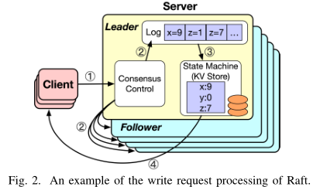
An example of the write request processing of Raft.
A write request from a client first comes to the consensus control (CC) module of the leader (i.e., Step 1).
CC begins the local log-appending of the leader and synchronizes the contents to all the followers in parallel (i.e., Step 2).
The leader needs to apply the written data into the state machine (e.g., a KV store) after the log is committed (i.e., Step 3).
Finally, the leader responds to the clients to accomplish the write request (i.e., Step 4).
Notes:
如图2所示，来自客户端的写入请求首先到达领导者的共识控制（CC）模块（即，步骤1）。CC开始对先导进行本地日志追加，并将内容并行同步到所有跟随者（即步骤2）。在提交日志（即步骤3）后，领导者需要将写入的数据应用到状态机（例如，KV存储）。最后，领导者响应客户端以完成写请求（即步骤4）。

Slide 5
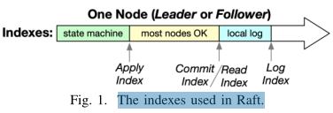
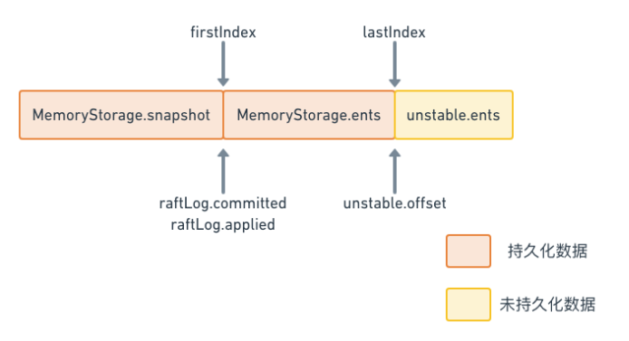
The indexes used in Raft.
raftLog由以下成员组成：
storage Storage：存放已经持久化数据。
unstable unstable：unstable结构体，用于保存应用层还没有持久化的数据。
committed uint64：保存当前提交的日志数据索引。
applied uint64：保存当前传入状态机的数据最高索引。

Slide 6
Read Processing of Raft
In Raft, all the read requests are forced to be processed by the leader.
Raft also introduces the read index to ensure linearizability . When the leader receives a read request, the request’s read index is set to the current commit index. Only when the leader’s apply index is no less than the read index, the leader can execute the read request and return the result to the client. In this case, we can ensure that the client would not get the out-of-date data.
Notes:
在Raft中，所有读取请求都必须由领导者处理。Raft还引入了读取索引以确保线性化[7]。当领导者收到读取请求时，请求的读取索引设置为当前提交索引。只有当领导者的应用索引不小于读取索引时，领导者才能执行读取请求并将结果返回给客户端。在这种情况下，我们可以确保客户不会获得过时的数据[4]

Slide 7
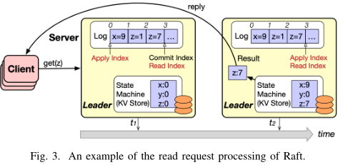
Read Processing of Raft
Raft’s read operation processing. As Fig shows, we assume the read index of GET(z) is 3, while the current apply index of the leader is only 0 at time t1. In this case, the leader has to apply the written data with the indexes 1 ∼ 3 into the state machine first before it is allowed to process GET(z) (i.e., time t2), in order to ensure the linear consistency, i.e., getting the right result "z = 7", but not "z = 0".
Notes:
Raft的读取操作处理。如图3所示，我们假设GET（z）的读取索引为3，而在时间t1时，引线的当前应用索引仅为0。在这种情况下，引线必须应用具有索引1的写入数据∼ 3在允许处理GET（z）（即时间t2）之前首先进入状态机，以确保线性一致性，即获得正确的结果“z=7”，而不是“z=0”。

Slide 8
Motivation
Raft has been widely used in many practical distributed systems, but not all constraints are necessary, especially for key value storage.
Among all the write processing steps of Raft introduced above, 1) the RPCs among the leader, the followers, and the client, 2) the log appending, and 3) the state machine applying may be the most time-consuming parts. For a system coupled with a high-speed network , the network overhead is low. And the structure of the log is very simple and the log-appending is usually a sequential I/O operation with higher speed. Thus updating the complicated state machine is the most possible to be the bottleneck of performance.
Therefore, if we can remove the applying phase from the shortest path of the Raft write processing, the consumed time will be much saved.
Notes:
Raft在许多实际分布式系统中得到了广泛的应用,但并非所有约束都是必要的，尤其是对于键值存储.
在上面介绍的Raft的所有写处理步骤中，1）领导者、追随者和客户端之间的RPC，2）日志附加，以及3）状态机应用可能是最耗时的部分。对于与高速网络耦合的系统，网络开销较低。日志的结构非常简单，日志附加通常是一个具有更高速度的顺序I/O操作。因此，更新复杂的状态机最有可能成为性能瓶颈。
因此，如果我们可以从Raft写入处理的最短路径中删除应用阶段，将大大节省所消耗的时间。

Slide 9
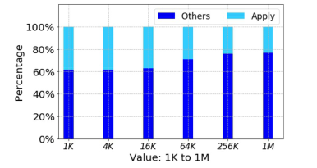
Motivation
Fig. 4 exhibits the consumed time percentage of the Apply stage and all the others when the value size ranges from 1KB to 1MB. It is obvious that Apply is actually slow and accounts for almost 40% of all the time of write request processing when the value size is less than 16KB, which is common for most applications.
Notes:
图4显示了当值大小在1KB到1MB之间时，应用阶段和所有其他阶段的消耗时间百分比。很明显，当值大小小于16KB时，Apply实际上很慢，几乎占写入请求处理时间的40%，这在大多数应用程序中很常见。

Slide 10
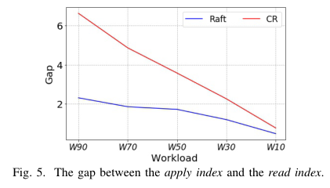
Motivation
In summary, commit return can always accelerate the write processing, but it may increase the processing time of some read requests because the gap between the two indexes is much larger than the original Raft.
From the results exhibited in Fig, we can get the following observations: 1) The gap is usually a considerable value, e.g., Raft leads to a gap around 2 for a read-write-balanced case (i.e., W 50). It means a read request has to wait for about two previous key-value pairs to be inserted into the KV engine first, and the insert operation (i.e., apply) is time-consuming. 2) For a workload with a larger write percentage, the gap is larger because more write requests have not been processed in time when a read request arrives. 3) For the Commit Return (CR) strategy discussed above, the gap between the two indexes is much larger than the original Raft, confirming the above conclusion that CR can boost write processing but may slow down the read processing.
Notes:
总之，提交返回总是可以加速写处理，但它可能会增加某些读取请求的处理时间。
从图5所示的结果中，我们可以得到以下观察结果：1）间隙通常是一个相当大的值，例如，对于读写平衡的情况（即W 50），Raft导致约2的间隙。这意味着读取请求必须先等待大约两个先前的键值对插入到KV引擎中，并且插入操作（即应用）非常耗时。2） 对于写入百分比较大的工作负载，差距较大，因为当读取请求到达时，没有及时处理更多的写入请求。3） 对于上面讨论的提交-返回（CR）策略，两个索引之间的差距远大于原始Raft，这证实了上述结论，即CR可以提高写入处理，但可能会减慢读取处理。

Slide 11
Motivation
If we can remove the waiting time caused by the gap between the apply index and the read index, the read performance will be significantly improved.
Notes:
如果我们能够消除应用索引和读取索引之间的差距导致的等待时间，则读取性能将显著提高。

Slide 12
Commit Return
The apply operation of the state machine usually takes a relatively long time during the Raft write processing. According to Raft, the write result can be returned to the client only after the apply operation is completed. However, in KV stores, since a write operation is to simply insert, update, or delete the value of a key, we can respond to the client immediately when the data is committed.
Because the commit completion requires more than half of the replica nodes have successfully appended the log, the written data is safe in the distributed systems when it is in the committed status. Finishing the apply operation is not necessary for writing, and thus it can be performed asynchronously in the background.
Notes:
在Raft写处理期间，状态机的应用操作通常需要相对较长的时间。根据Raft，只有在应用操作完成后，才能将写入结果返回给客户端。然而，在KV存储中，由于写入操作只是简单地插入、更新或删除密钥的值，因此我们可以在提交数据时立即响应客户端。
由于提交完成需要超过一半的副本节点已成功附加日志，因此当写入的数据处于提交状态时，它在分布式系统中是安全的。编写时不需要完成应用操作，因此可以在后台异步执行。

Slide 13
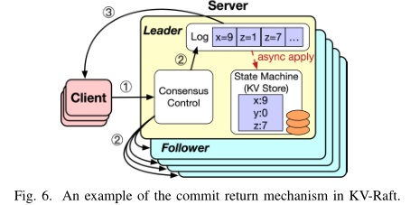
Commit Return
Commit Return. As Fig. 6 plots, compared with the original write procedure of Raft shown in Example 2.1, Commit Return returns the write result to the client in advance when the commit operation is completed, reducing the step count from 4 to 3. The apply operation is performed asynchronously in the background.
Notes:
提交返回。如图6所示，与示例2.1中所示的Raft的原始写入过程相比，提交返回在提交操作完成时提前将写入结果返回给客户端，将步骤数从4减少到3。应用操作在后台异步执行。

Slide 14
Immediate Read
In Raft, the read operation waits for the apply index to catch up with the read index before performing the read operation; especially when commit return is implemented, the gap between the apply index and the read index will get larger, resulting in longer waiting time.
Since the read operations for key-value pairs are simple, instead of waiting, we can directly execute the read request based on the log data copy that locates in DRAM, which is used for log replication and applying in Raft. In this way, the read performance will be much promoted. Although the read procedure is different with Raft, the Immediate Read of KV -Raft can guarantee linear consistency.
In a KV store, the read operations can be divided into three categories: GET(key), SCAN(startKey, endKey), and SCAN(startKey, count), which means to get the KV pairs for the number of count sequentially since startkey.
Notes:
在Raft中，读取操作在执行读取操作之前等待应用索引赶上读取索引；特别是在实现提交返回时，应用索引和读取索引之间的差距将变得更大，从而导致更长的等待时间。
由于键值对的读取操作很简单，因此我们可以直接基于位于DRAM中的日志数据副本执行读取请求，该副本用于日志复制和Raft中的应用。这样可以大大提高读取性能。虽然读取过程与Raft不同，但KV-Raft的即时读取可以保证线性一致性。
在KV存储中，读取操作可分为三类：GET（键）、SCAN（startKey，endKey）和SCAN（startKey，count），这意味着从startKey开始按顺序获取计数数量的KV对。

Slide 15
Processing GET in Immediate Read.
For the GET operations, we can read the in-memory Raft logs between the apply index and the read index from back to front to search the target key, because the later logs contain the newer versions.
If the target key is found in these logs, its related value will be returned immediately to the client directly without reading the state machine; if it is not found, we will read the target key from the state machine.
Since the Raft’s logs are in memory, and only the logs between the apply index and the read index need to be read, the time to read these logs is very small compared to the time to wait for these logs to be applied.
Notes:
对于GET操作，我们可以从后向前读取apply索引和read索引之间的内存Raft日志来搜索目标键，因为后面的日志包含较新的版本。如果在这些日志中找到目标密钥，则其相关值将立即直接返回给客户端，而无需读取状态机；如果没有找到，我们将从状态机读取目标密钥。由于Raft的日志在内存中，并且只需要读取应用索引和读取索引之间的日志，因此与等待应用这些日志的时间相比，读取这些日志的时间非常短。

Slide 16
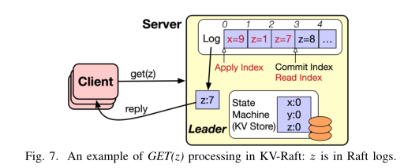
Processing GET in Immediate Read.
An Example of Immediate Read: GET(key) in which the key is in the logs between the apply index and the read index. As Fig. 7 plots, the leader receives a read request GET(z) from the client.
First, the leader sets the read index of the read request to the current commit index, i.e., 3, and then search the target key z from log 3 to log 1. It is fortunate that the key z is found when reading the log 3. Then, the result z : 7 is returned to the client immediately; during the whole read process, the state machine is never read.
Notes:
即时读取的示例：GET（键），其中键位于应用索引和读取索引之间的日志中。如图7所示，领导者从客户端接收读取请求GET（z）。首先，领导者将读取请求的读取索引设置为当前提交索引，即3，然后从日志3搜索目标键z到日志1。幸运的是，在读取日志3时找到了键z。然后，结果z:7立即返回给客户端；在整个读取过程中，从不读取状态机。

Slide 17
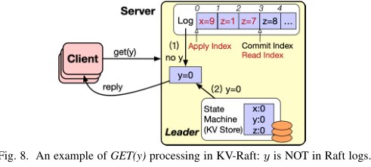
Processing GET in Immediate Read.
An Example of Immediate Read: GET(key) in which the key is NOT in the logs between the apply index and the read index. As shown in Fig. 8, assuming the current commit index is 3, the leader starts to search the inmemory logs from the index 3 to 1 after it receives Get(y).
Unfortunately, the target key y is not found between the logs 1 and 3. Then, the leader needs to read the key y from the state machine and return the result y : 0 to the client.
Notes:
即时读取的示例：GET（键），其中键不在应用索引和读取索引之间的日志中。如图8所示，假设当前提交索引为3，则在接收Get（y）后，前导开始从索引3到1搜索inmemory日志。不幸的是，在日志1和3之间找不到目标密钥y。然后，领导者需要从状态机读取密钥y，并将结果y:0返回给客户端。

Slide 18
Processing GET in Immediate Read.
For the SCAN operations, i.e., range queries, we also do not need to wait for the apply index to catch up with the read index.
However, different from GET, we should perform reading both the inmemory Raft logs between the apply index and the read index from front to back and the state machine at the same time for SCAN. The reason lies in that we cannot make sure that the in-memory logs contain all the target data for range queries.
Note that the result of the SCAN operation from the Raft logs is in order. Thus after getting the results from both the inmemory logs and the state machine, we can perform a merge sort for the two parts of results, and the data from logs have higher priority for the same key.
Two types of SCAN operations, i.e., SCAN(startKey, endKey) and SCAN(startKey, count) are usually supported; and their detailed processing in Immediate Read is a bit different in the result merging phase. For SCAN(startKey, endKey), all the results from the logs and the state machine will be merged into the final result. But some of the results from the logs and the state machine may be discarded during the result merging for SCAN(startKey, count) when the final result size is equal to count.
Notes:
对于扫描操作，即范围查询，我们也不需要等待应用索引赶上读取索引。然而，与GET不同的是，我们应该从前到后读取应用索引和读取索引之间的内存Raft日志，并同时读取状态机进行扫描。原因在于我们无法确保内存日志包含范围查询的所有目标数据。请注意，Raft日志的扫描操作结果是正确的。因此，在从内存日志和状态机获得结果后，我们可以对结果的两部分执行合并排序，并且来自日志的数据对同一密钥具有更高的优先级.
通常支持两种扫描操作，即扫描（开始键，结束键）和扫描（开始键，计数）；它们在即时读取中的详细处理在结果合并阶段略有不同。对于扫描（开始键、结束键），来自日志和状态机的所有结果将合并到最终结果中。但是，当最终结果大小等于count时，在扫描的结果合并过程中（startKey，count），可能会丢弃来自日志和状态机的一些结果。

Slide 19
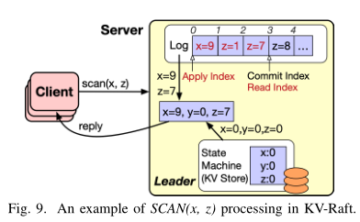
Processing GET in Immediate Read.
An Example of Immediate Read: SCAN(startKey, endKey). A read request of SCAN(x, z) is sent to the leader, as Fig 9 illustrates. Assuming the current commit index is 3, the leader will perform reading from the log 1 to log 3 and the state machine at the same time. The result {x : 9, z : 7} is gotten from the logs; the state machine returns {x : 0, y : 0, z : 0}. Then the leader merges the two parts of the results together. Because the in-memory logs contain relatively newer data, the overlapped keys, i.e., x and z, in the two result sets adopt the result of logs. Therefore, the final read result is {x : 9, y : 0, z : 7} and is returned to the client. Note that without reading from the state machine, y will not be put into the read result.
Notes:
即时读取示例：扫描（开始键，结束键）。扫描（x，z）的读取请求被发送到先导，如图9所示。假设当前提交索引为3，则领导者将同时执行从日志1到日志3和状态机的读取。结果{x:9，z:7}来自日志；状态机返回{x:0，y:0，z:0}。然后领导者将结果的两部分合并在一起。由于内存日志包含相对较新的数据，因此两个结果集中的重叠键，即x和z，采用日志的结果。因此，最终读取结果为{x:9，y:0，z:7}，并返回给客户端。注意，如果不从状态机读取，y将不会被放入读取结果中。

Slide 20
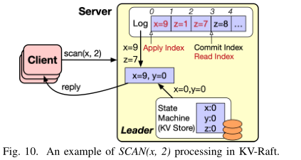
Processing GET in Immediate Read.
An Example of Immediate Read: SCAN(startKey, count). Plotted as Fig 10, when the leader receives a read request SCAN(x, 2) and the current commit index is 3, the leader reads the in-memory logs from index 1 to 3 and the state machine at the same time. The log reading leads to a result set {x : 9, z : 7}, while the result of the state machine is {x : 0, y : 0}. Finally, the two result sets are merged to {x : 9, y : 0}, because z from the logs is out of the final result sets (i.e., x and y) and x : 0 from the state machine is overwritten by x : 9 from the logs with higher priority.
Notes:
即时读取示例：扫描（开始键，计数）。如图10所示，当先导接收到读取请求扫描（x，2）且当前提交索引为3时，先导同时读取索引1到3的内存日志和状态机。日志读取导致结果集{x:9，z:7}，而状态机的结果是{x:0，y:0}。最后，两个结果集合并到{x:9，y:0}，因为日志中的z在最终结果集之外（即x和y），并且状态机中的x:0被具有更高优先级的日志中的x:9覆盖。

Slide 21
Experimental Setup
The experiments were performed in a cluster consisted of five high I/O nodes; each node is coupled with Linux Centos 7.6.1810, 8GB DRAM, and an enterprise-level 200GB NVMe Solid State Drive (SSD). Limited by the environment, the intranet bandwidth among the nodes is 1.5Gbps. Three of the nodes serve as TiKV nodes, one as PD, and the last one runs the benchmark tool, i.e., Go-YCSB.
In the experiments, each key-value pair contains a 16B key and a 1-KB value by default, and the data has 3 replicas in TiKV . The keys obey the Zipf distribution by default. The workloads include an insert-only (Load) workload, a read-only (RO) workload, the mixed workloads consisting of 90%, 70%, 50%, 30%, or 10% of writes and point queries (i.e., GET) operations (i.e., W90 ∼ W10). And there are similar workloads mixed with writes and different ratios of range queries (i.e., SCAN) operations (i.e., S10 ∼ S90 and SO for SCAN-only).
First, we initialized the key-value store by randomly inserting 100 million KV pairs with a total of about 100GB data. Then we performed the workloads W90, W70, W50, W30, W10, RO, S10, S30, S50, S70, S90, and SO. All these workloads include 10 million requests each. Because the write requests used here belong to the type of update, the total data size is always maintained as about 100GB.

Slide 22
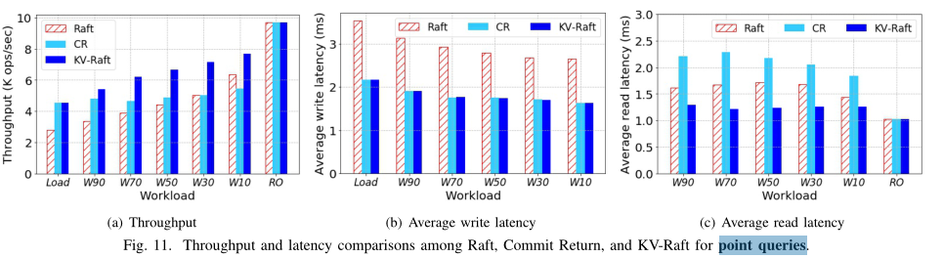
Point Queries

Slide 23
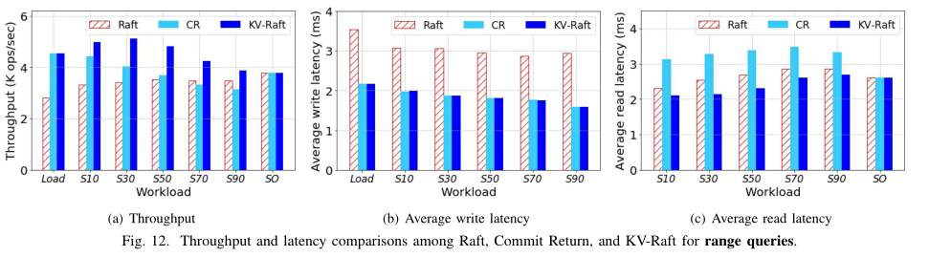
Point Queries

Slide 24
Conclusion
Consensus and consistency assurance is one of the core components of distributed systems, and also becomes the bottleneck of performance for modern hardware-based distributed systems.
However, some of the strict constraints that affect performance much imposed by Raft, one of the most commonly used consensus algorithms, are found not to be necessary for distributed key-value storage systems.
We propose an improved consensus algorithm entitled KV-Raft to substantially boost key-value stores by breaking some of Raft’s limitations on reading and writing procedures.
KV -Raft is very productive and easy to implement, with great potential to be widely adopted for accelerating distributed KV stores.
Notes:
一致性和一致性保证是分布式系统的核心组件之一，也是现代基于硬件的分布式系统性能的瓶颈。然而，对于分布式键值存储系统，发现一些影响Raft（最常用的共识算法之一）性能的严格约束不是必需的。我们提出了一种改进的共识算法，名为KV-Raft，通过打破Raft在读写过程中的一些限制，大大提高了键值存储。KV-Raft生产效率高，易于实施，在加速分布式KV存储方面具有很大的潜力。

